Slide 1


/Let a bot deal with your static analysis warnings backlog
EclipseCon 2022
27/10/2022
27-10-2022 | Aman Sharma | Khashayar Etemadi

Slide 2
/TABLE OF CONTENTS
/01
/STATIC ANALYSIS WARNINGS
/02
/SORALD
/03
/DEMO
/04
/EXPERIMENTS
27-10-2022 | Aman Sharma | Khashayar Etemadi

Slide 3



/WHO ARE WE?
Research Engineer @ KTH
PHD Student @ KTH
amansha@kth.se
khaes@kth.se
KTH, Stockholm, Sweden
KTH, Stockholm, Sweden
27-10-2022 | Aman Sharma | Khashayar Etemadi

Slide 4
/STATIC ANALYSIS WARNING?
“A potential bug in the program found without executing it”
27-10-2022 | Aman Sharma | Khashayar Etemadi

Slide 5

/STATIC ANALYSIS WARNING: EXAMPLE
return a.equals(“foo”);
String a = null;
cALLING .equals on a can result in null pointer exception
String a = null;
return “foo”.equals(a);
27-10-2022 | Aman Sharma | Khashayar Etemadi

Slide 6

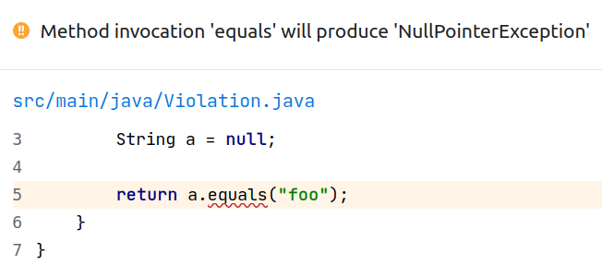
/HOW TO FIND THEM?
27-10-2022 | Aman Sharma | Khashayar Etemadi

Slide 7

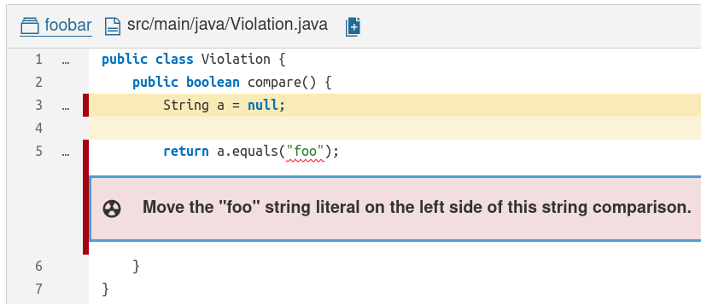
/HOW TO FIND THEM?
A.K.A S1132
27-10-2022 | Aman Sharma | Khashayar Etemadi

Slide 8

<IT IS ALSO A !BUG!>
27-10-2022 | Aman Sharma | Khashayar Etemadi

Slide 9
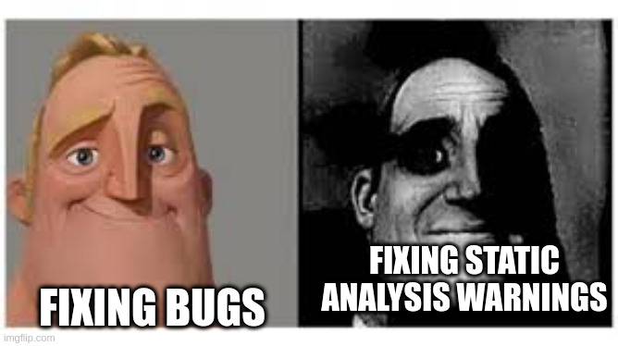
“LOTS OF OTHER THINGS TO DO RIGHT NOW”
Something more actionable is required.
27-10-2022 | Aman Sharma | Khashayar Etemadi

Slide 10
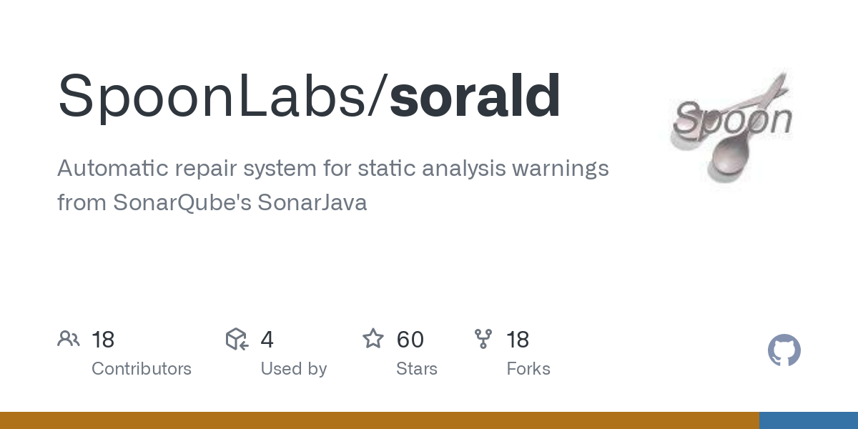

Slide 11


Slide 12
/ABSTRACT SYNTAX TREE
main
int main() {
return 0;
}
Abstract Syntax Tree (AST): tree to represent the structure of the program
int
return
0
27-10-2022 | Aman Sharma | Khashayar Etemadi

Slide 13
/SPOON
/AST TRANSFORMATION
/HIGH FIDELITY PRETTY-PRINTING
main
main
main
int main() {
return 1;
}
int
return
int
return
int
return
0
1
1
27-10-2022 | Aman Sharma | Khashayar Etemadi

Slide 14
/HOW SORALD WORKS: DEEP DIVE
Hey, Sorald! Repair this for me, please?
04:20
Sorald
On it. @sonarqube, do you find violations?
04:21
SonarQube
Yes. I find S1132 at line 3 column 8.
04:21
Sorald
Let me do the AST transformation now :)
04:21
Sorald
@spoon, please make it pretty. :*
04:21
Spoon
Sure thing. @user, here you go!
04:22
So grateful to all of you <3
04:22
27-10-2022 | Aman Sharma | Khashayar Etemadi

Slide 15
/DEEP DIVE CONCLUSION
S1132
1
2
3
4
1 String a = null;
2
3 return a.equals(“foo”);
.equals
.equals
1 String a = null;
2
3 return “foo”.equals(a);
a
“foo”
“foo”
a
27-10-2022 | Aman Sharma | Khashayar Etemadi

Slide 16
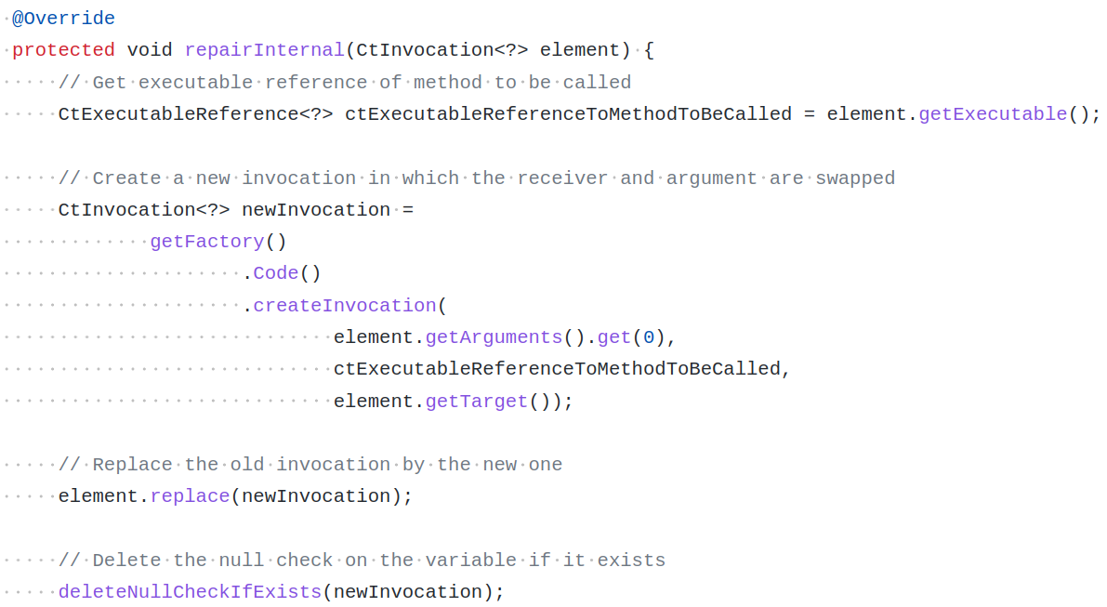
/SOURCE CODE EXAMPLE
27-10-2022 | Aman Sharma | Khashayar Etemadi

Slide 17




/WAYS TO USE SORALD
Choose your favourite:
$ java -jar sorald.jar repair
$ mvn sorald:repair
27-10-2022 | Aman Sharma | Khashayar Etemadi

Slide 18

/DEMO (STEPS)
/Mining
/Repairing
/Re-mining
/Compile
We use Sorald’s miner to find violations
We use Sorald’s repair to fix violations
We mine violations again to check if they are fixed
We compile to ensure we have not introduced an error
27-10-2022 | Aman Sharma | Khashayar Etemadi

Slide 19
/DEMO (COMMANDS)
Let’s see how Sorald works in action:
We repair a project by SonarSource: Sonar-Scanner-Cli@5c518d6
https://github.com/SonarSource/sonar-scanner-cli
We use Sorald’s maven plugin
We fix violations of S1132
We re-mine violations and compile the project after the repair
S1132: “Strings literals should be placed on the left side when checking for equality”
Solution: Move the literal to the left
$ mvn se.kth.castor:sorald:repair -DruleKey=S1132
27-10-2022 | Aman Sharma | Khashayar Etemadi

Slide 20
/EXPERIMENTING IN THE WILD
/161 Popular Repos
/10 Sonar Rules
We select 161 Github repos:
More than 50 stars
PR & CI friendly
Active & Maven
Healthy (mvn compile)
We experiment with 10 rules:
Bug type
Common in past experiments
27-10-2022 | Aman Sharma | Khashayar Etemadi

Slide 21
/EXPERIMENTING IN THE WILD: SELECTED RULES
Thread.run() should not be called directly.
Synchronization should not be based on Strings or boxed primitives.
Resources should be closed.
BigDecimal(double) should not be used.
hashCode and toString should not be called on array instances.
InterruptedException should not be ignored.
Math operands should be cast before assignment.
toString() and clone() methods should not return null.
Iterator.next() methods should throw NoSuchElementException.
Strings and Boxed types should be compared using equals().
27-10-2022 | Aman Sharma | Khashayar Etemadi

Slide 22
<65%>
Violations fixed in 161 projects
27-10-2022 | Aman Sharma | Khashayar Etemadi

Slide 23
54 patches for 80 newly introduced violations in 350 days
27-10-2022 | Aman Sharma | Khashayar Etemadi

Slide 24
Courtesy: eclipse/repairnator
17
10
2
Number of merged PRs
Number of closed PRs
Number of pending PRs
*As of the date of publication
27-10-2022 | Aman Sharma | Khashayar Etemadi

Slide 25
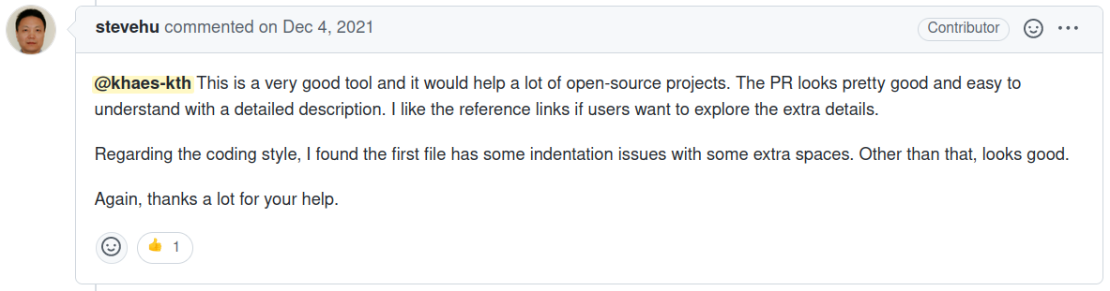
27-10-2022 | Aman Sharma | Khashayar Etemadi

Slide 26

/RELATED TOOL
https://www.sonarsource.com/products/sonarlint/
27-10-2022 | Aman Sharma | Khashayar Etemadi

Slide 27
/FUTURE IMPROVEMENTS
/Add More Analyzers
/Filter Out Unacceptable Patches
There are other analyzers to be plugged in:
Qodana
SpotBugs
…
Unacceptable patches can be filtered out:
False positive warnings Eg. str1==str2
Uncertain fixes
27-10-2022 | Aman Sharma | Khashayar Etemadi

Slide 28
<AUTOMATIC REPAIR TOOL>
<AST TRANSFORMATIONS>
<PART OF DEVELOPMENT PROCESS>
27-10-2022 | Aman Sharma | Khashayar Etemadi

Slide 29
/THANKS!
Voting Link
amansha@kth.se
khaes@kth.se
Link to GitHub repository: https://github.com/SpoonLabs/sorald
White Paper: https://ieeexplore.ieee.org/document/9756950
CREDITS: This presentation template was created by Slidesgo, and includes icon by Flaticon, and infographics & images by Freepik
27-10-2022 | Aman Sharma | Khashayar Etemadi

